Slide 1
Emergency Command Center
Carino, Ellana, Rivera, Tonoike

Slide 2
Problem Statement
In areas not covered by cellular network providers or in times when power lines and cell towers are down due to natural disasters, post-disaster Relief and Recovery teams have no way of communicating with each other to coordinate efforts except with expensive satellite phones or walkie talkies.

Slide 3
Proposed Solution
E-Nodes / Emergency Command Center
A pop-up mesh network composed of lightweight Raspberry-Pi access points
Each loaded with their own Web server front end and its own NoSQL database backend
Configured to be plug-and-play
Access Point Discoverable / Automatic IP address leasing (hostapd, DHCP)
Network connectivity (OLSRD Routing / WPA2 Passcode)
Web service (DNS / Data Replication)

Slide 4
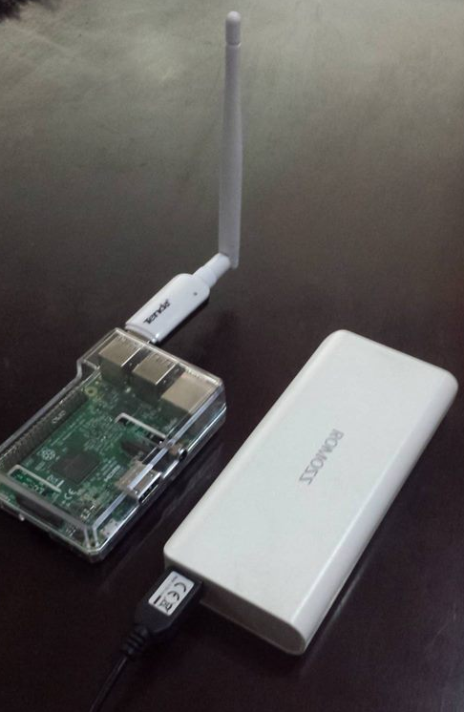
Assembled Node with Battery Pack

Slide 5
E-Nodes
6 Steps to using E-Nodes
1. Create a Deployment Plan
2. Plug devices to battery pack
3. Place devices on key locations
4. Give WPA2 Passcode to PointMan
5. Connect to the Wi-Fi network
6. Access the application via a Web Browser

Slide 7
Project Objectives
This project aims to find a cost efficient and easily-deployable method to establish communication among users such as Disaster Recovery personnel or Rescue Aid through the use of Wi-Fi capable mobile devices during post-disaster events where there are no currently available network infrastructure to connect to.

Slide 8
System Analysis & Detailed Design
Use Case Diagram
Context Level Diagram
Data Flow Diagram
Entity Relationship Diagram

Slide 9
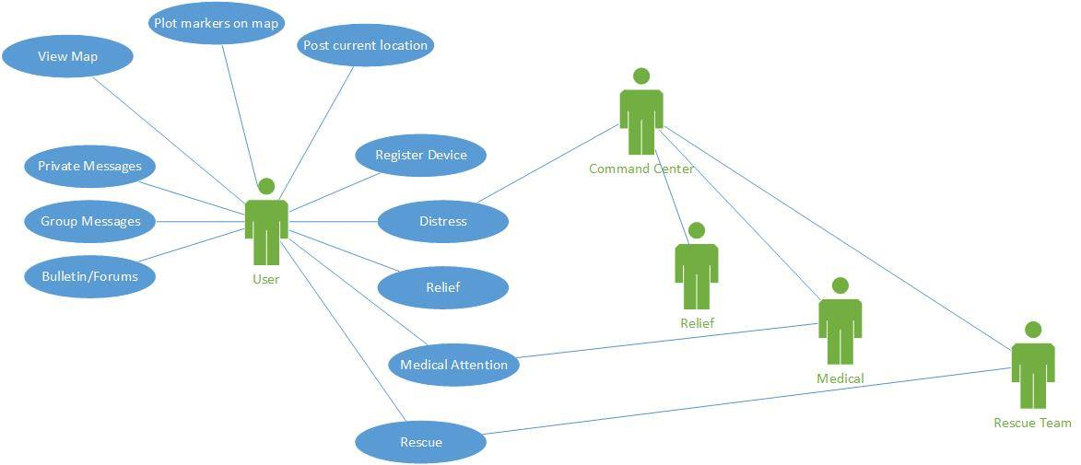
Use Case Diagram

Slide 10
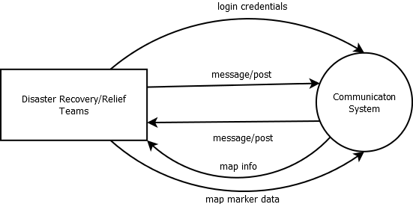
Context Diagram

Slide 11
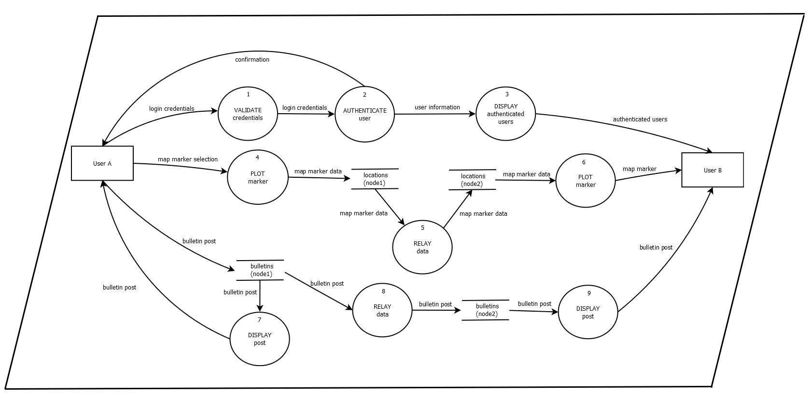
Data Flow Diagram

Slide 12
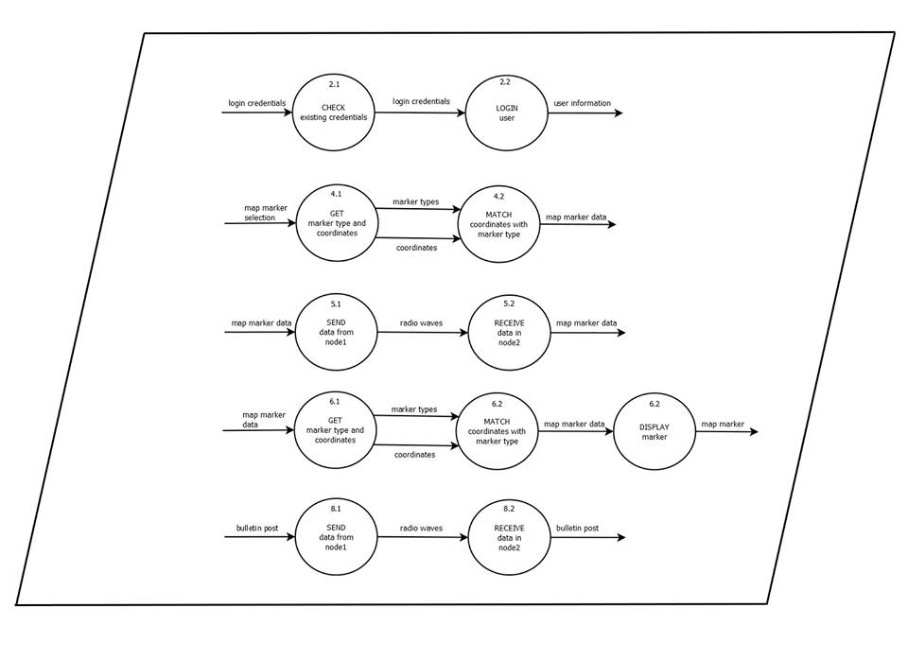
Data Flow Diagram

Slide 13
Entity Relationship Diagram
We recently shifted to a NoSQL database (MongoDB)

Slide 14
Current Prototype
Current State
2-Hop (A to C in A - B – C setup) Node data transfer
Distributed NoSQL Database with data Replication
Login with MAC address detection
Rocket.chat Communication Website

Slide 15
To do
Network Quality Testing
Database Replication Load Testing
Integration of modules
Map (Source offline maps first/Get GPS data)
Plotting Function
Communication (Rocket.chat)
Distress signal (Get GPS data)
Alerts
Field Testing with Web Application

